Slide 1
Designing of forms, reports creation of relationships
SHEHAR BANO
FA21-BCE-021

Slide 2
Contents:
Objective.
Definition of forms.
Example.
Relationships and its type.

Slide 3
Objective of report:
The main objective in this lab is to learn about how to make reports, forms and relationships between two tables whether the relation may be many-to-one, many-to-many or one-to-one.

Slide 4
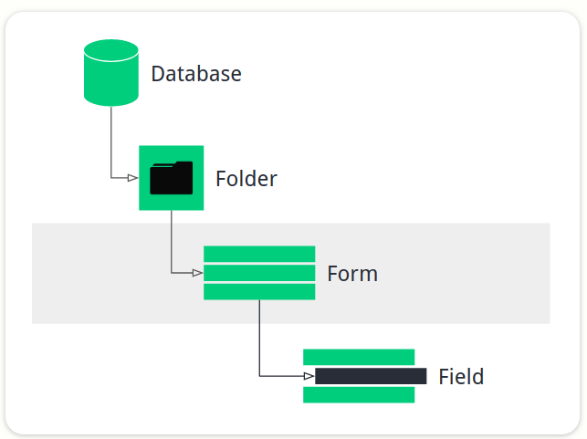
Form
A Form defines the various data to be collected, and how they link together. Usually, a Form will represent part of the information you wish together.

Slide 5
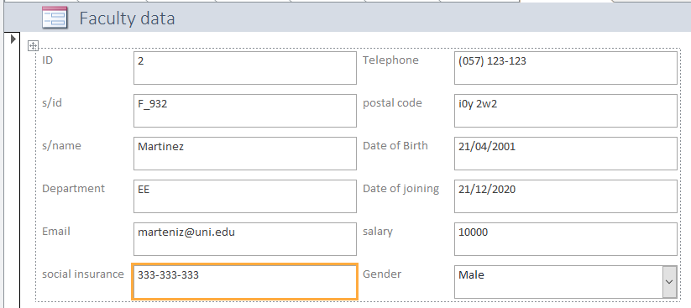
Example

Slide 6
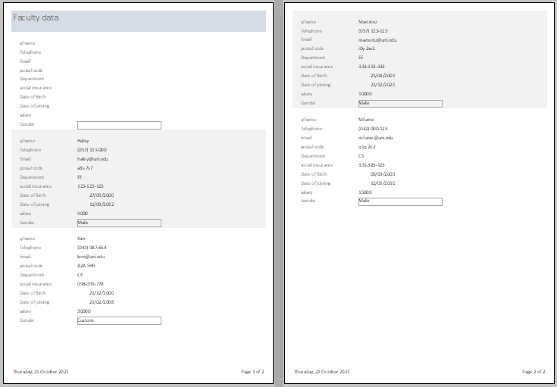
Report view

Slide 7
Relationship in database
it is an association between tables. Those associations create using join statements to retrieve data.
Types
1.One to one relationship.
2.One to many relationship.
3.Many to many relationship.

Slide 8
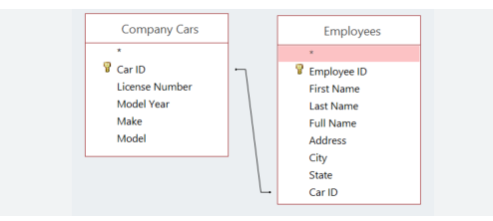
One to one
It is used to create a relationship between two tables in which a single row of the first table can only be related to one and only one records of a second table.
Primary key
Foreign key

Slide 9
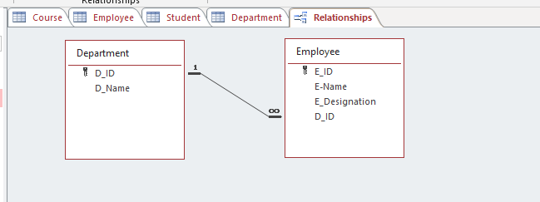
One to many
Any single rows of the first table can be related to one or more rows of the second tables, but the rows of second tables can only relate to the only row in the first table. It is also known as a many to one relationship
Primary key
Foreign key

Slide 10
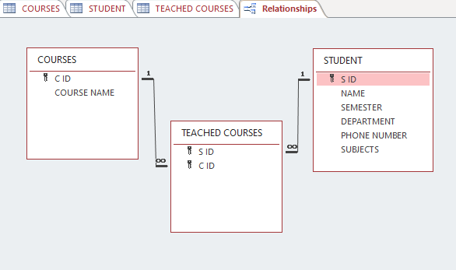
Many to many
It is represented by N:N relationship.
Foreign key
Primary key
Primary key

Slide 11


